Slide 1
H-WATCH proposal
(H-PROJECT 1st Plan)

Slide 2

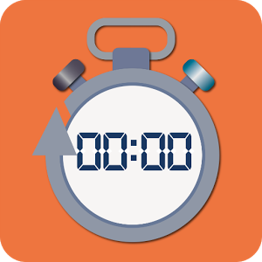
1. What is H-watch
Service to help people prepare for the exam
H-WATCH
Total Study Time
Subjects Study Time
Statistical chart
Conversion Hard Mode

Slide 3


2. Main Functions
H-WATCH is composed on primary four functions
1. Total time Check
2. Subjects time Check
Total
Subjects
Total
00:00
Subject1
30:04
Statics
Subject2
Subjects
40:20
Subject3
Subject4
10:16
Statics
3. Statistical Chart
30:04
4. Hard Mode
Subject1
Subject2
Subject3
Total
27:16
Subjects
Total
Statics
Subjects
15:04
00:00
Statics
Disconnect

